Slide 1

The Link Between Cardiovascular Mortality and Socioeconomic Status in the U.S.
Randy Chan, Corey Kretzmer, Andrew Krog

Slide 2
Hypothesis & Motivation
Hypothesis: Lower socioeconomic status is correlated with higher rates of cardiovascular mortality
Why do we care? Nearly 1 in 4 deaths in the U.S. is due to cardiovascular disease
Why socioeconomic status? Most risk factors are well understood and ‘modifiable’ based on behavior unlike socioeconomic status

Slide 3
Questions
Are there geographic differences in rates of cardiovascular mortality?
Do counties with lower education levels have higher rates of cardiovascular mortality?
Do counties with lower incomes have higher rates of cardiovascular mortality?

Slide 4
Data Sources
Center for Disease Control (CDC): annual deaths caused by major cardiovascular diseases (rate per 100,000 people) by county from 2012-2016
U.S. Census Bureau American Community Survey: educational attainment & median income by county

Slide 5
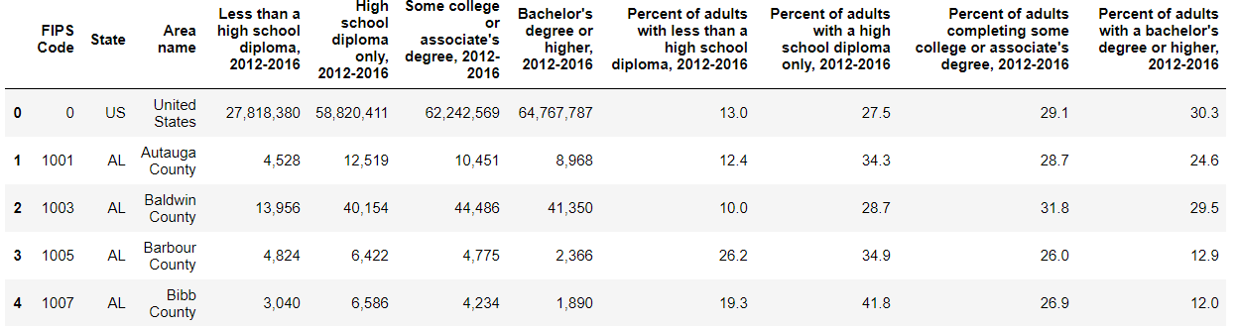
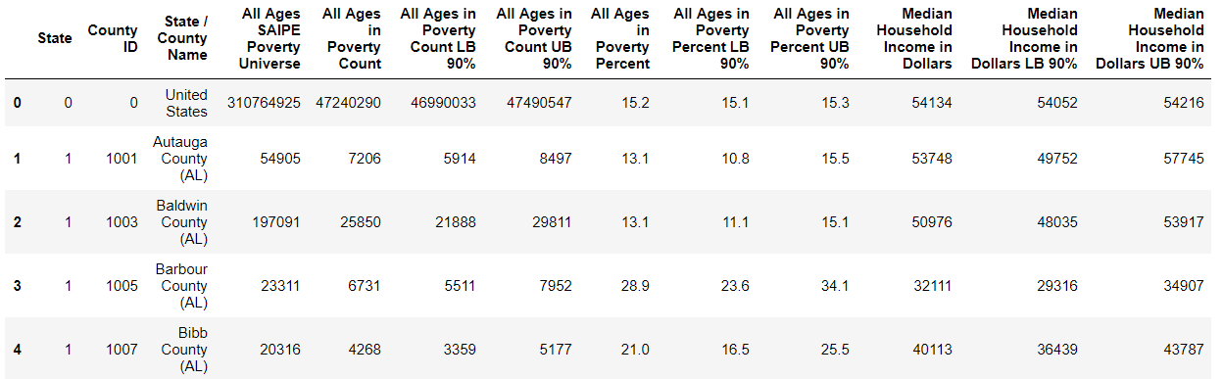
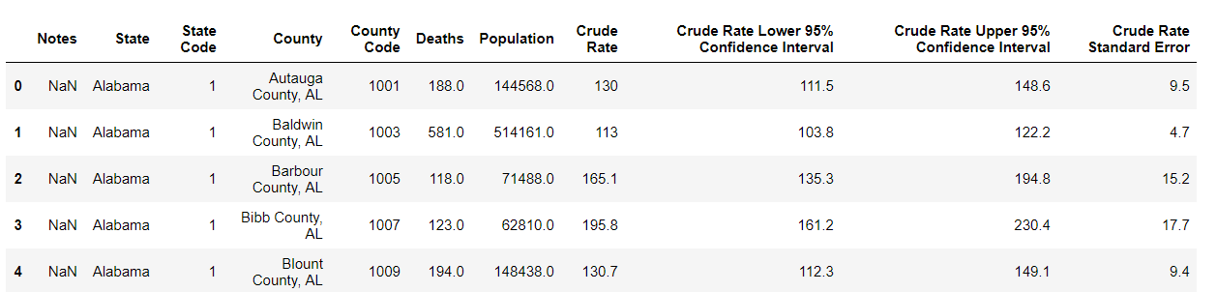
Original DF – Education Income Mortality

Slide 6
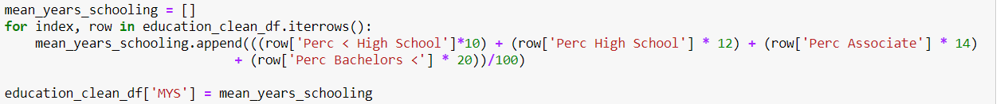
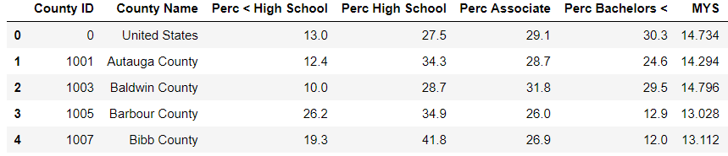
Data Cleanup & Data Interpretation
< High School: 10 years of schooling
High School Degree: 12 years of schooling
Some college: 14 years of schooling
Bachelor’s degree or higher: 20 years of schooling
Accounting for Bachelor, Master or Doctorate degrees

Slide 7
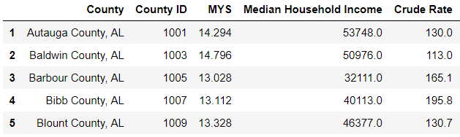
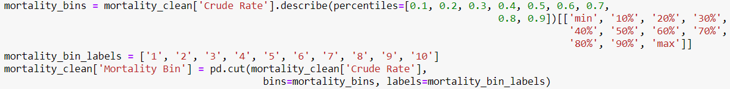
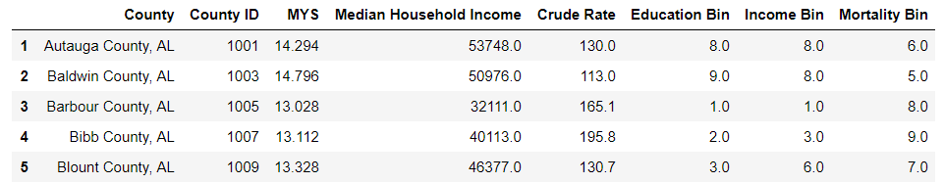
Data Cleanup & Data Interpretation Cont.
Create Bins for comparison

Slide 8
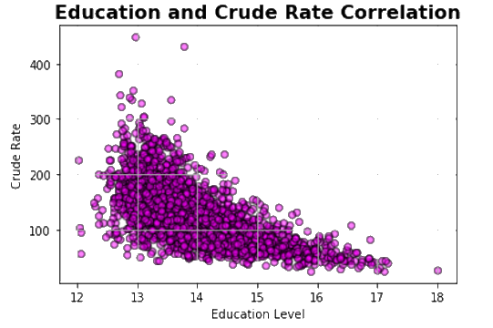
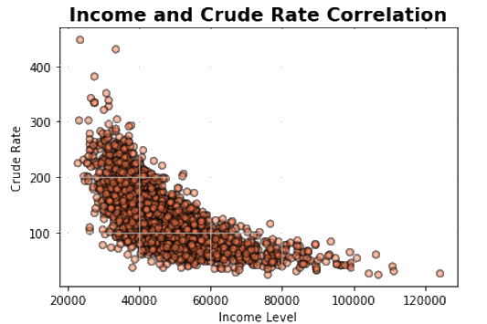


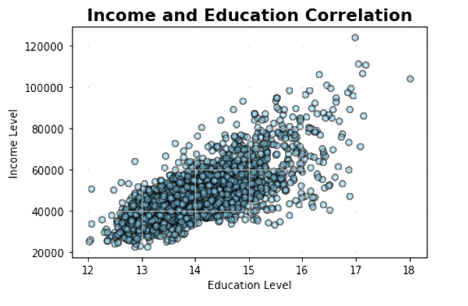
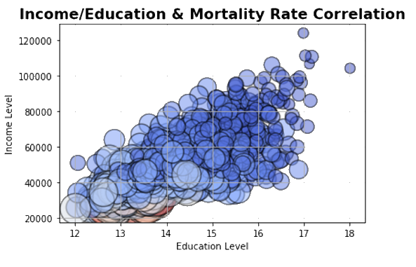

Correlations – Income Education Crude Rate
Linear regression R-value of 0.71 shows that there is a correlation between Income and Education level.
Linear regression R-value of -0.64 shows that there is an inverse relation between Education and Crude Cardiovascular Mortality Rate.
Linear regression R-value of -0.73 shows that there is a correlation between Income and Crude Cardiovascular Mortality Rate.

Slide 9
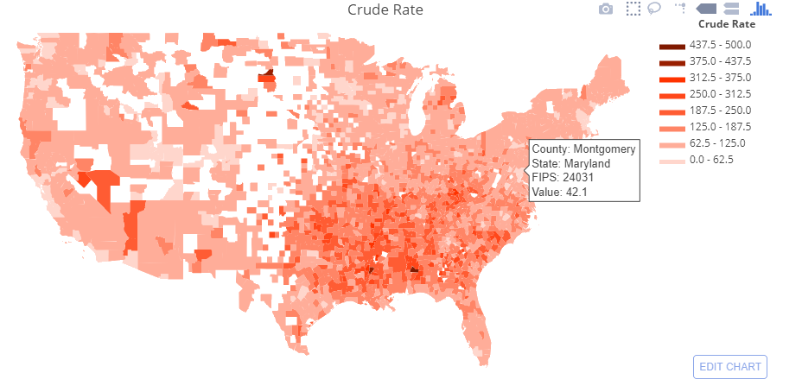
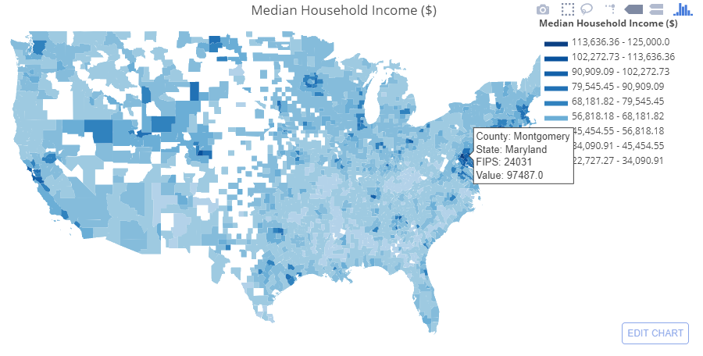
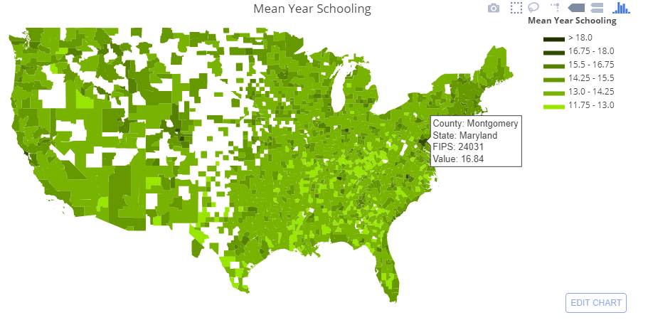
Comparison – Montgomery, MD
Crude Rate for Montgomery County, MD is 42.1, which means that every 100,000 people, 42 die each year from heart disease. It represents one of the lowest mortality rates of all counties.
Median Household Income for Montgomery County is $97,487, which represents one of the higher income level bucket
Mean Year Schooling for Montgomery County is 16.84, which represents one of the highest buckets for years in school

Slide 10
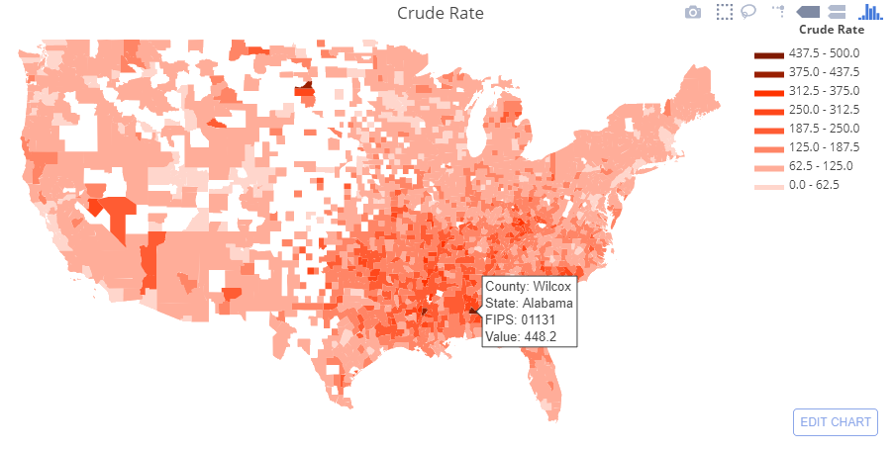
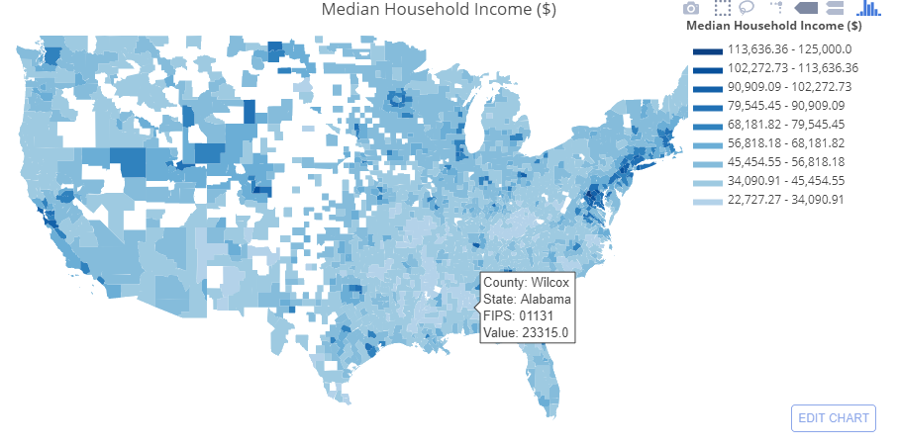
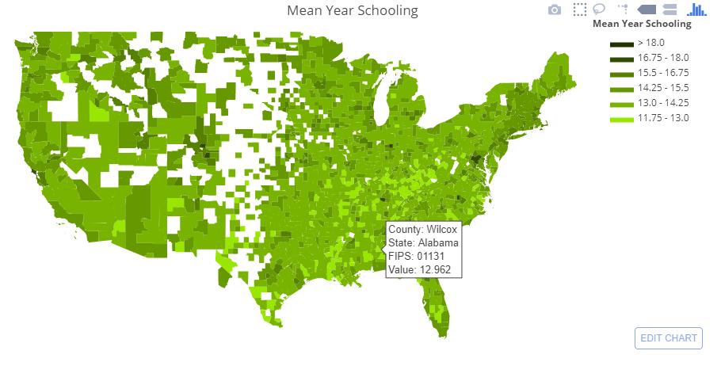
Comparison – Wilcox, AL
Crude Rate for Wilcox, AL is 448.2, which means that every 100,000 people, 448 die each year from heart disease. It represents one of the highest rates of all counties.
Median Household Income for Montgomery County is $23,315, in the lowest 10% of counties
Mean Years of Schooling for Montgomery County is 12.96 years, which represents the lowest bucket for years in school

Slide 11
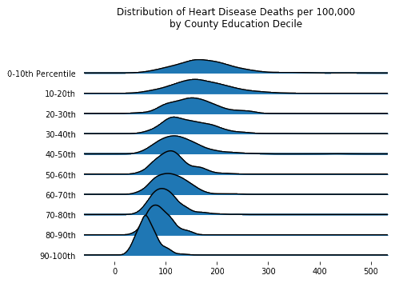
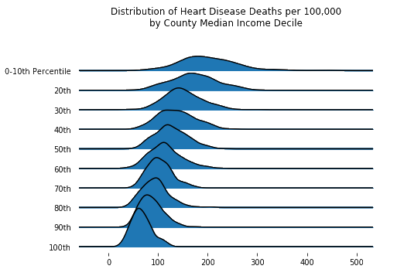
Data Ladder- Mortality Rate by Group
As Income and Education level rise, the average mortality rate shifts lower and the distribution narrows
The bottom 10% of counties by median income have an average cardiovascular mortality rate THREE TIMES as high as the top 10% at 200 deaths per 100,000 vs only 66. Education shows a similar difference between the top and bottom
Counties in the bottom groups have a wider range of distribution in mortality rate. This does introduce some questions for our data’s limitations in being predictive of a county’s cardiovascular-related mortality rates.

Slide 12
Answers to our Questions
Are there geographic differences in rates of cardiovascular mortality?
Yes. The mid-south “stroke belt” had much higher average county mortality rates than other regions
Do counties with lower education levels have higher rates of cardiovascular mortality?
Yes. The average mortality rate for the bottom 10% of counties by mean years of school was 2.7 times that of the top 10%
Do counties with lower incomes have higher rates of cardiovascular mortality?
Yes. The average mortality rate for the bottom 10% of counties by median income was 3 times that of the top 10%

Slide 13

Caution Regarding the Conclusion
This only provides a high level view of avertable deaths. It serves as a reminder for people about the importance of socioeconomic determinants of health, but there are many other outside factors that will affect mortality rates.
The data is from 2012 – 2016 which may not reflect the current economy or current condition in the county. The data gathered is based on mortality rates within each county from cardiovascular diseases, but one cannot assume that all the deaths or heart disease can be prevented by education or income alone. There are many other outside factors such as living and working conditions, cleaner air and drinking water, access to nutritious food, crime rate, etc. All of these factors increase a person’s chances of living a healthier, longer life.

Slide 14


